Slide 1
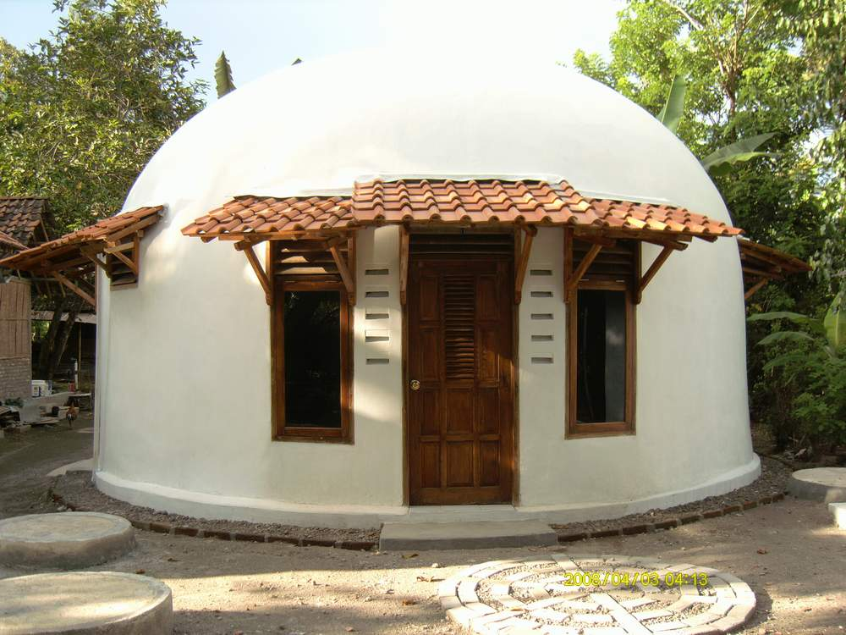
7. Design an earthquake safe building

Slide 2
7. Design an earthquake safe building
By the end of the lesson you should be able to:
Identify a successful design for an earthquake safe building and list the construction materials that could be used.
Show how people inside and outside the building will be safer during an earthquake.
Explain how water, electricity and gas supplies could be protected from earthquake damage.

Slide 3
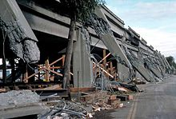
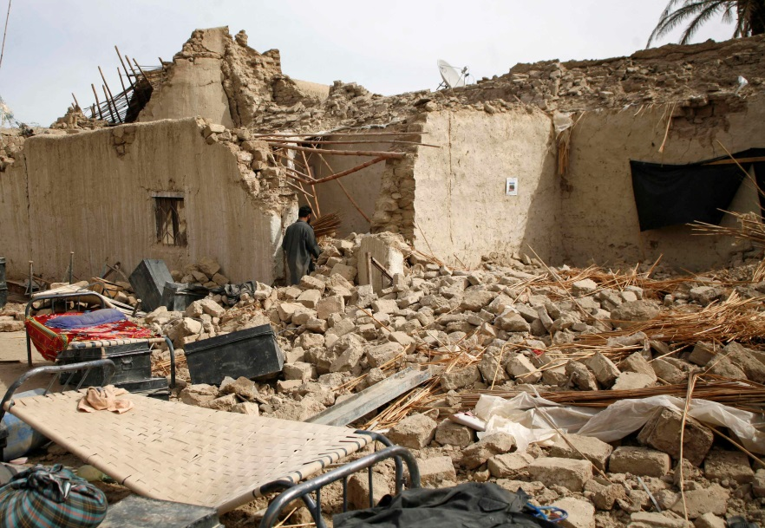
Similar sized earthquakes but very different results
San Francisco, 1989
67 dead
2,000 homeless
6.9 Richter scale
Bam, Iran, 2003
30,000 dead
70,000 homeless
6.7 Richter scale.
Although the earthquake in Bam was slightly smaller it killed 70,000 people compared to 67 in San Francisco, but why?

Slide 4
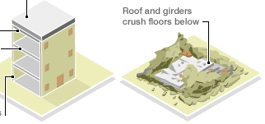
Traditional Houses in Bam
Heavy roof sealed with cement.
Roof and girders crush floors below.
Steel roof girders
Extra floor added to increase living space.
Mud brick walls, no support beams
Earthquake causes bricks to separate and crumble

Slide 5
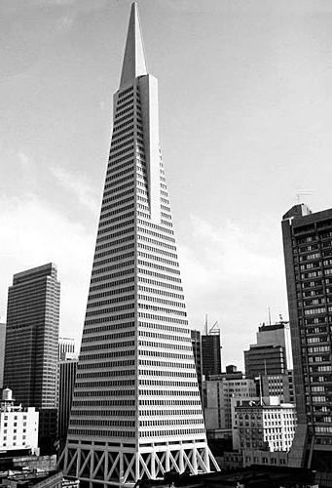
An earthquake safe building in San Francisco
  The Transamerica Pyramid in San Francisco was built to withstand earthquakes.
  In the 1989 earthquake it swayed more than 1 foot but was not damaged.
  It is built on very solid ground that is less likely to fracture during an earthquake.

Slide 6

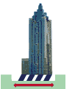
Two ways a building can withstand an Earthquake
The foundations are solid but the building moves so it doesn’t fracture during an earthquake.
The building is solid but the foundations move so it doesn’t fracture during an earthquake.

Slide 7
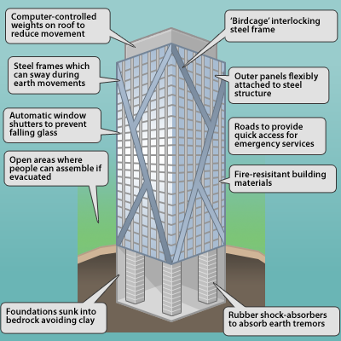
A design for an earthquake safe tower block

Slide 8
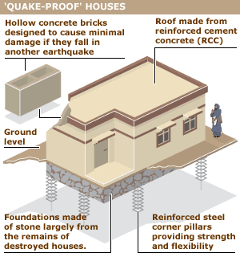
A design for an earthquake proof house.

Slide 9
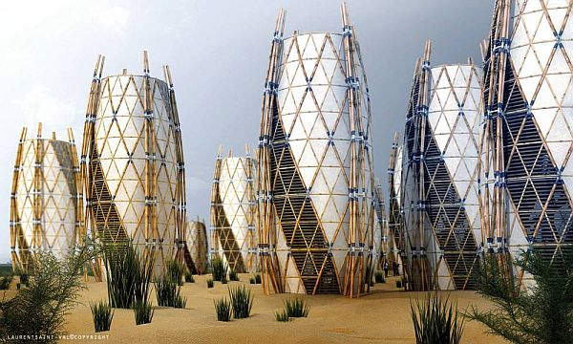
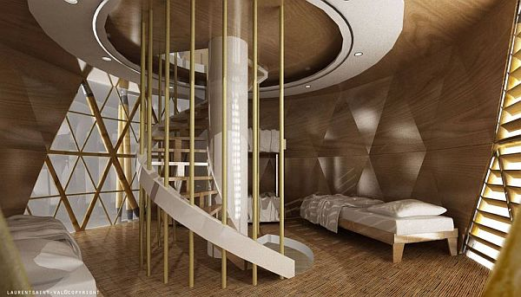
Earthquake-safe homes made of bamboo
Haiti is a poor country. In 2010 an earthquake killed thousands of people and made many homeless.
These bamboo homes are built using traditional basket weaving skills. Local natural fibres are interwoven and moulded into a cocoon shape.
Bamboo is a cheap building material. It is flexible and strong, making the houses earthquake-safe.
The homes are also resistant to high winds and floods.

Slide 10
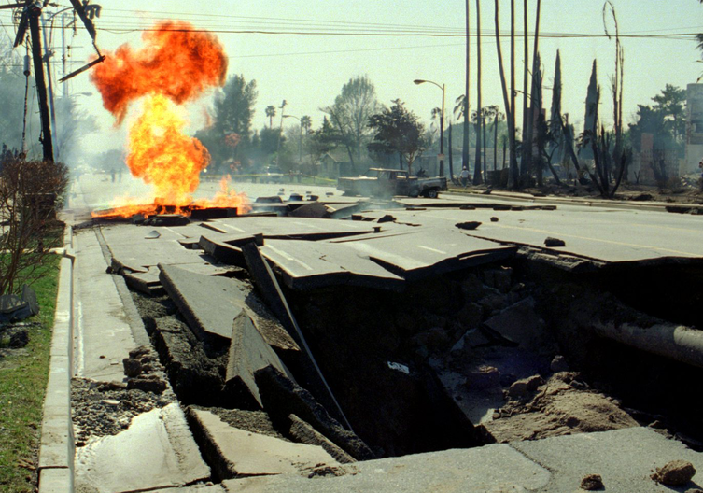
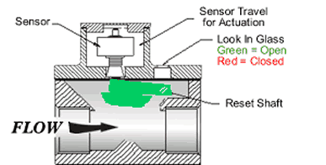
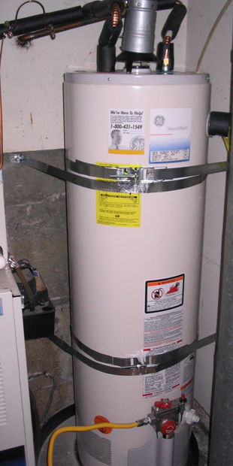
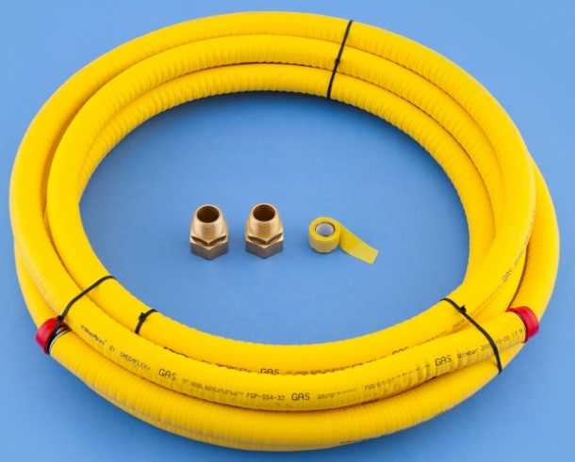
Making homes safer for everyone
Gas leaks from pipe ruptures after an earthquake are a major cause of fires.
Earthquake activated shut-off valves on gas pipes into house.
Flexible gas and water pipe fittings to all appliances to avoid ruptures during ground movement.
A bracing kit for a water heater made out of heavy metal strappings and bolted to the wall.

Slide 11
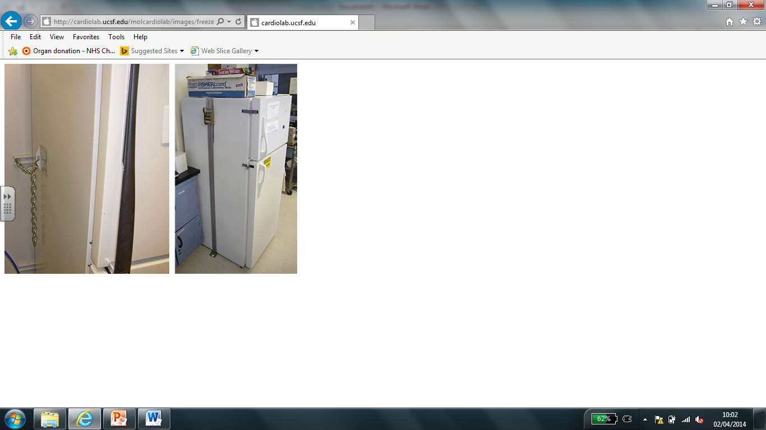
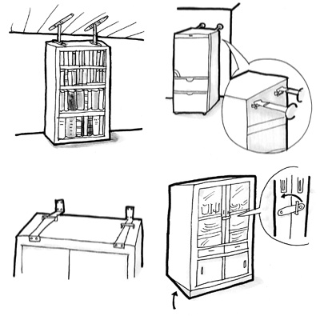
Making fixtures and furnishing earthquake proof
Even a weak earthquake can overturn furniture and dislodge pictures from walls.
Secure all pictures and mirrors to the walls. Ensure that lights are fixed correctly to the ceiling.
Stop fridges and cookers from rolling by bolting them to the kitchen floor.
Strap bookcases to walls to prevent overturning. Ensure that all doors have good latches to stop them from flying open.

Slide 12
Questions to consider when designing an earthquake safe building for a poorer country like Iran
1. How will you stop the building from collapsing?
2. How will people inside the building be protected as it moves?
3. What about falling glass and rubble on the people below?
4. What about problems after the earthquake: gas and water leaks?
5. Will the building be located away from built up areas or near to emergency services?

Slide 13
Plenary
The size of the earthquake on the Richter scale does not mean there will be more damage and destruction.
What is more important is how people are respond to earthquakes and how much money can be spent on making buildings, bridges and pipes more earthquake safe.
Therefore richer countries like Japan and the USA have less problems and fewer deaths caused by earthquakes.

